Slide 1
The Art of Measuring Nothing
Royal Aeronautical Society – Human Factors Group
Predicting the fatal flaws
26 November 2015

Slide 2
Agenda
Short introduction/background
Avinor study
Organizational processes model
Study results

Slide 3
Eric Arne Lofquist
Associate Professor at BI Norwegian Business School –Campus Bergen - Norway
  Executive Masters program in Health, Safety and Environment (HSE)
US Navy Commander (28 years active service)
  15 years flying F-14 ”Tomcats” from US Navy Aircraft Carriers (USS Nimitz)
  Deputy base commander New Orleans Industrial complex
Director of consulting – Powersim (System Dynamics)

Slide 4
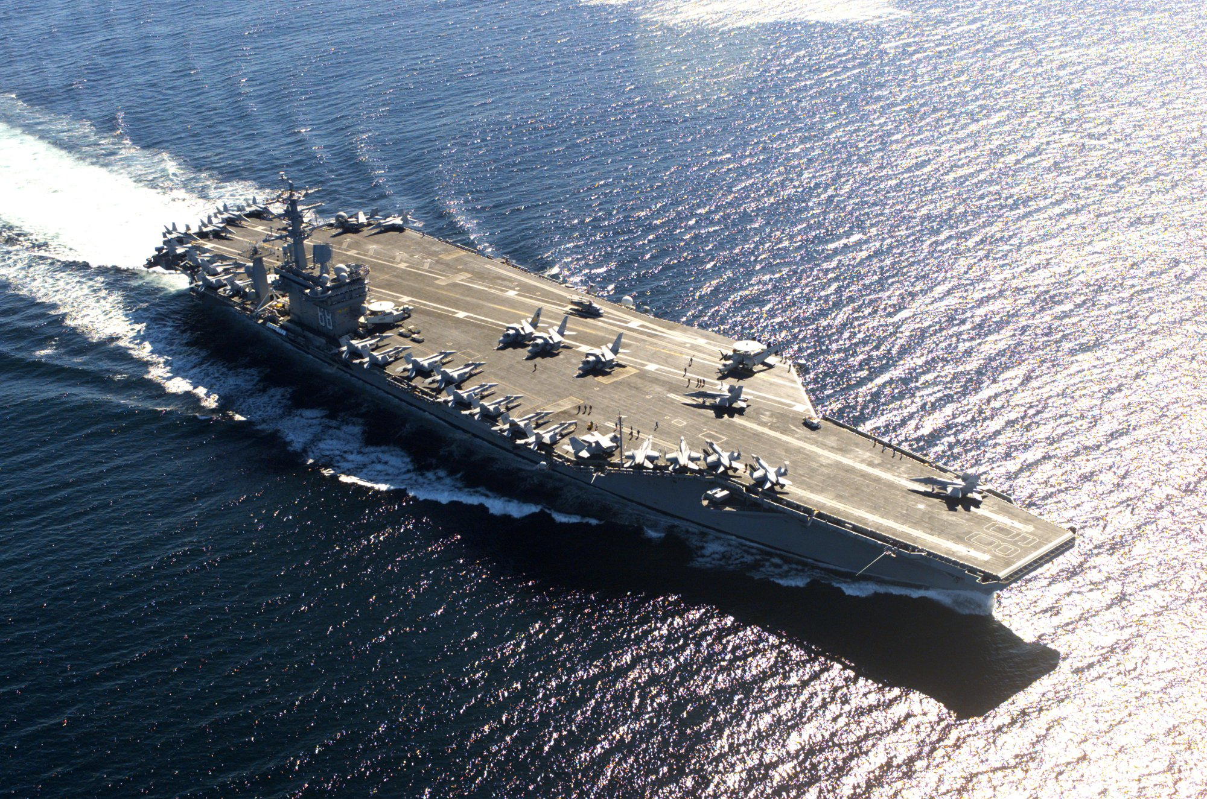
USS Nimitz CVN-68
Notes:
4

Slide 5
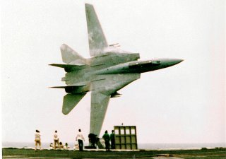

Slide 6
Safety Literature
Most safety literature today is written by a combination of sociologists, psychologists and/or engineers ”each with specific paradigms for understanding certain parts of complex socio-technical systems” (Karlene Roberts, 2001)
  Engineering and statistical modeling (Engineers)
  Social science (Sociology and Psychology)
  Human factors (Psycholgists and engineers)
A recurring issue is that there is often no theoretical link to other safety research

Slide 7

Take-Off 05 project
«Corporatization of air navigation services in Norway»
(2003-2005)

Slide 8
Academic papers
Lofquist, E.A. (2008) Measuring the effects of strategic change on safety in a High Reliability Organization. Doctorial Dissertation.
Lofquist, E.A. (2010) The art of measuring nothing: The paradox of measuring safety in a changing civil aviation industry using traditional safety metrics. Safety Science 48 (2010) 1520–1529
Lofquist, E.A., Greve, A., and Olsson, U.H. (2011) Modeling attitudes and perceptions as predictors for changing safety margins during organizational change. Safety Science 49 (2011) 531–541

Slide 9
High Reliability Organizations
(HRO)

Slide 10
Personal perspective on safety and HROs
1976 US Navy Flight School – first day
  ”Look at the person next to you ...”
1976-1978 Seven (7) Classmates killed in training
1978-1979 First operational cruise on USS Nimitz – 14 crashes/14 pilots killed
25 May 1980 USS Nimitz crash and fire
This was the birthplace of HRO

Slide 11
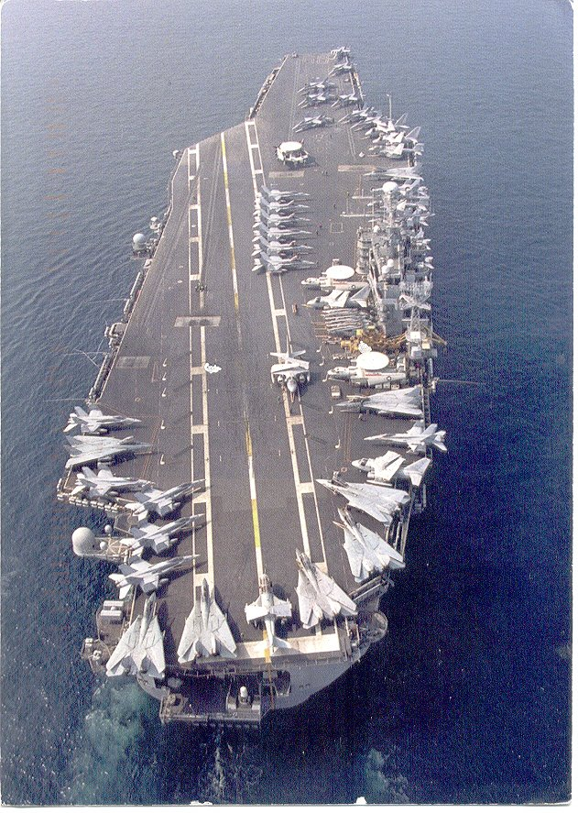

Slide 12
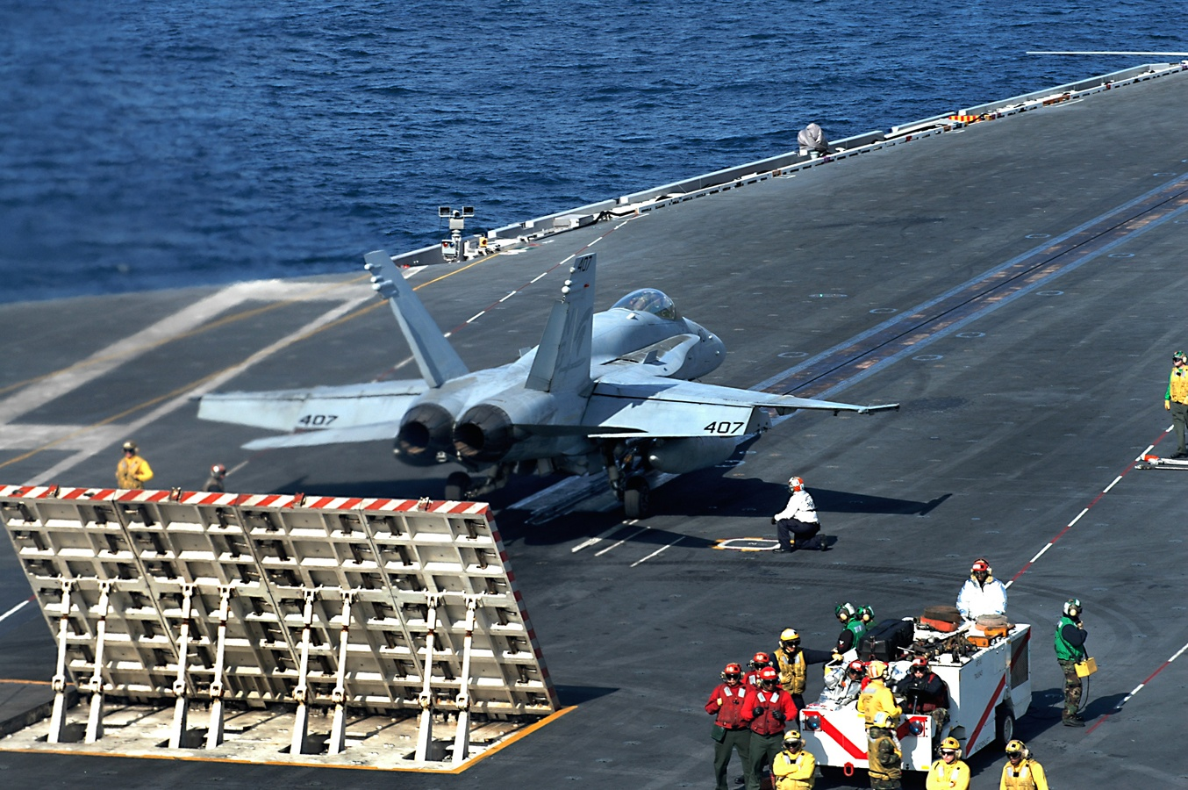

Slide 13
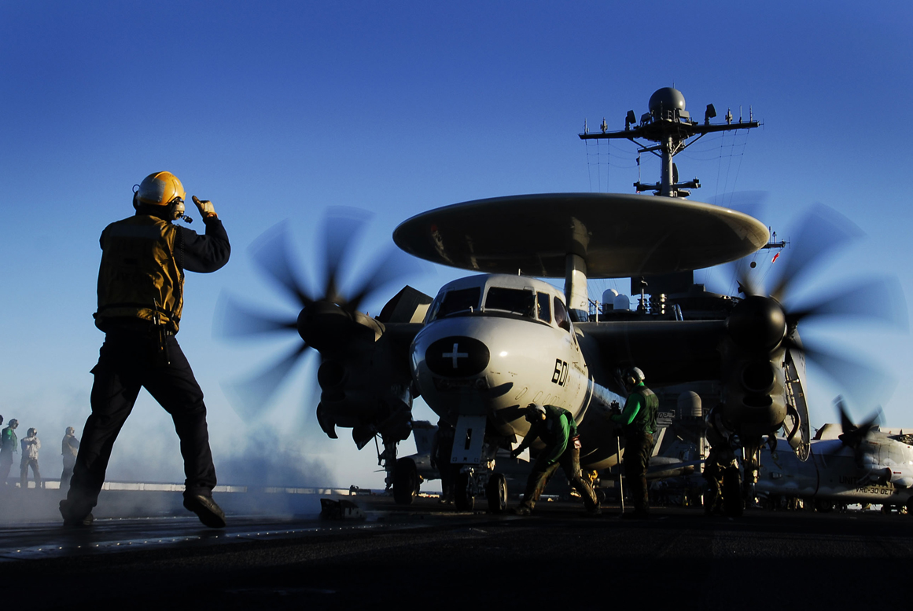

Slide 14
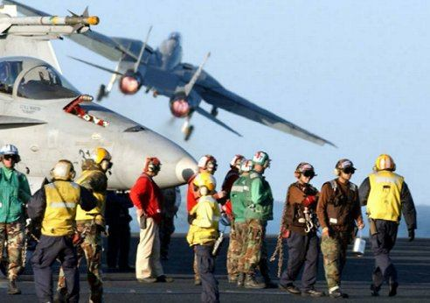

Slide 15
Safety theories
Man-made disasters (Turner, 1978)
Normal Accident Theory (Perrow, 1984)
High Reliability Organizations (Rocklin, La Porte, and Roberts, 1987)
Organizational accidents (Reason, 1990)
Limits to safety (Sagan, 1993)
Collective mind and mindfulness (Weick and Roberts, 1993; Weick and Sutcliffe, 2006)
Challenger launch decision (Vaughan, 1996)
Überlingen (Johnson, 2004)
Resilience Engineering (Hollnagel et al., 2006)

Slide 16
Organizational processes model
(Lofquist, 2008:2010)
Socio-technical system
System Design
System Operation
System Outcomes
Proactive
Phase
Interactive
Phase
Reactive
Phase
Organizational Culture
Environment
Time

Slide 17
Key concepts
Socio-technical systems
Complexity (bounded rationality)
Dynamic-adaptive behavior of systems
Gap between routines as imagined/enacted
Control- vs. commitment-based systems
  Rules, regulations, procedures, routines, checklists, etc.
Compliance

Slide 18
Key concepts (2)
The role of organizational culture and climate
Trial and error learning
Latent failures/conditions
Incubation periods
Organizational drift/deviance
Barriers/operational redundancy
Signals

Slide 19
Key concepts (3)
Tight vs. loose coupling (with delay)
Incidents and accidents (near misses)
Undesired events/outcomes
Consequence
Human error/variation
Root causes

Slide 20
Double-loop learning
(Argyris & Schön, 1974)
Real world
signals
Single-
loop
Decisions
Information
feedback
Double-
loop
Action strategies
decision rules
Mental models of
real world

Slide 21
Organizational «double-loop» learning
(Lofquist, 2008:2010)
Socio-technical system
System Design
System Operation
System Outcomes
Proactive
Phase
Interactive
Phase
Reactive
Phase
Organizational Culture
Environment
Time

Slide 22
Organizational «double-loop» learning
(Lofquist, 2008:2010)
Socio-technical system
System Design
System Operation
System Outcomes
Proactive
Phase
Interactive
Phase
Reactive
Phase
Organizational Culture
Environment
Time

Slide 23
Organizational «double-loop» learning
(Lofquist, 2008:2010)
Socio-technical system
System Design
System Operation
System Outcomes
Proactive
Phase
Interactive
Phase
Reactive
Phase
Organizational Culture
Environment
Time

Slide 24
Take-Off 05 project
«Corporatization of air navigation services in Norway»
(2003-2005)

Slide 25
Three year longitudinal study
Avinor leadership survey (2002-2005)
Safety in Norwegian civil aviation during change processes (2005)
60 Individual semi-structured interviews (2005)

Slide 26
Conceptual causal model
Perceptions of
Leadership
Commitment
+
+
Attitude toward
Change
Perception
of Safety
+
+
Perception of
Safety
Culture
+

Slide 27
Safety Measurement Model Results
Perceptions of
Leadership
Commitment
0.64
0.54
Attitude toward
Change
Perception
of Safety
0.28
-0.02
Perception of
Safety
Culture
0.25
Total causal effect of 0.72
RMSEA = 0.030

Slide 28
Could the Germanwings flight 18G accident have been avoided?

